Slide 1

DANGEROUS CARGO PROCEDURE
A GENERAL GUIDANCE
12th.Oct.2016
By LODG
1

Slide 2

SCHEME
• Pricing
• Booking
• Loading
• Documenting
• Educating
1
2

Slide 3

GO FOR PRICING
• If there is a defined UN No.(IMO) from
shipper or in SDS, please follow below.
- Check policies “in advance” www.yangming.com
service/Dangerous cargo information (YM DG Policy only) or DGMS
as2.yangming.com/ilis DGMS/Important Notice (Partner’s DG Policy)
- Check discharging / transshipment port
as2.yangming.com/ilis DGMS/DG Local Practice
• General cargo of chemical material and its
products with any suspicion & doubt.
- Send SDS to DG Center (LODG)
dgcenter@yangming.com or lodg@yanming.com
3
3

Slide 4
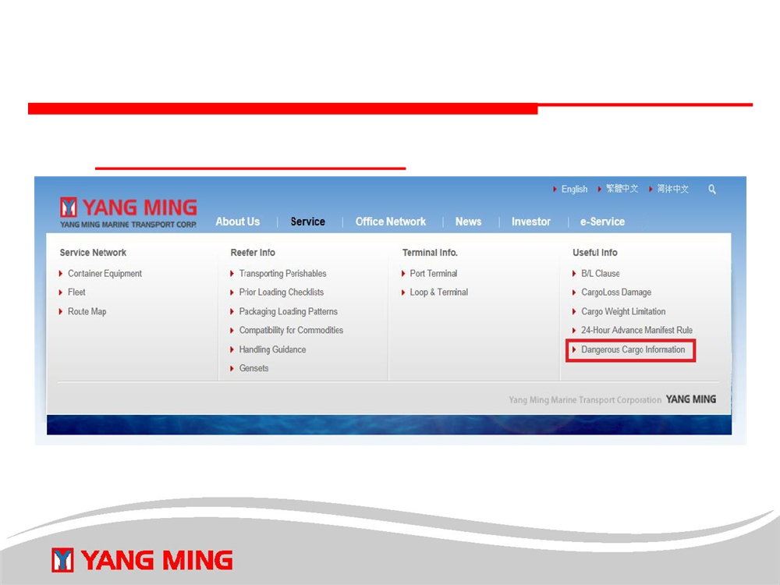
YM DG Policy location
www.yangming.com
4

Slide 5
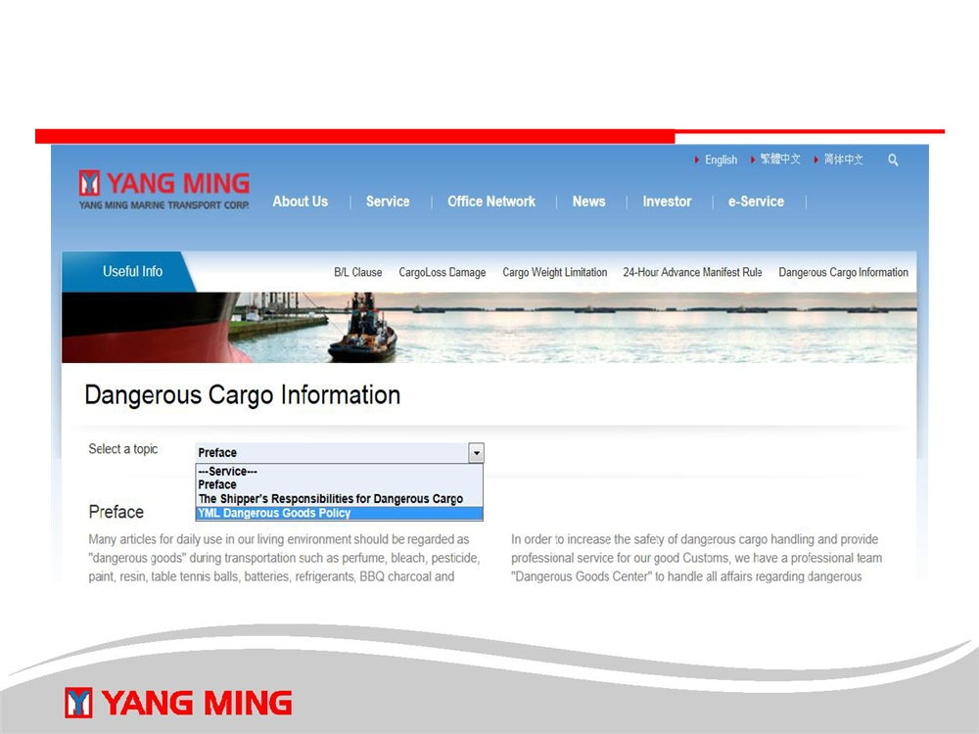
YM DG Policy location
3
5

Slide 6
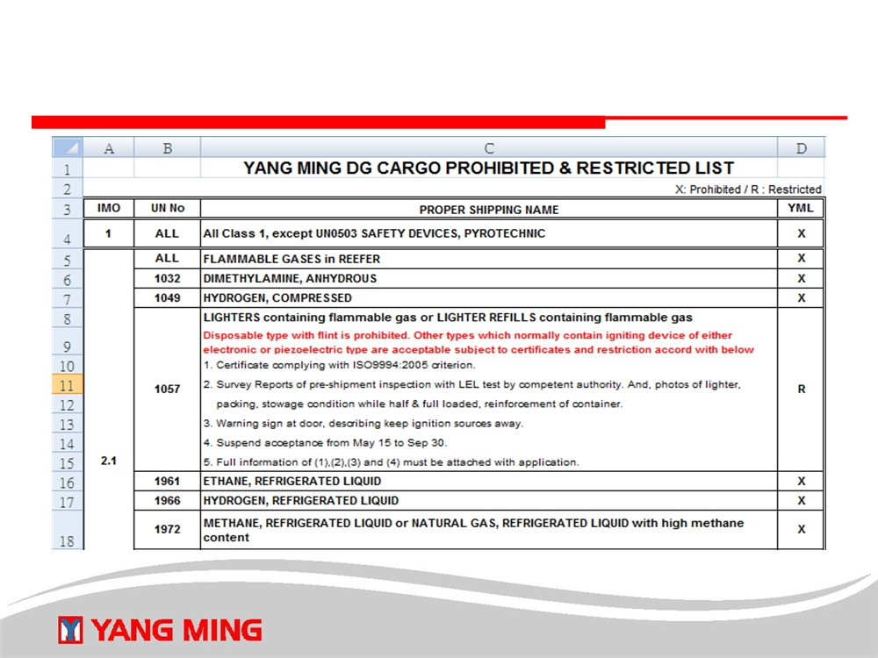
YM DG POLICY
6

Slide 7
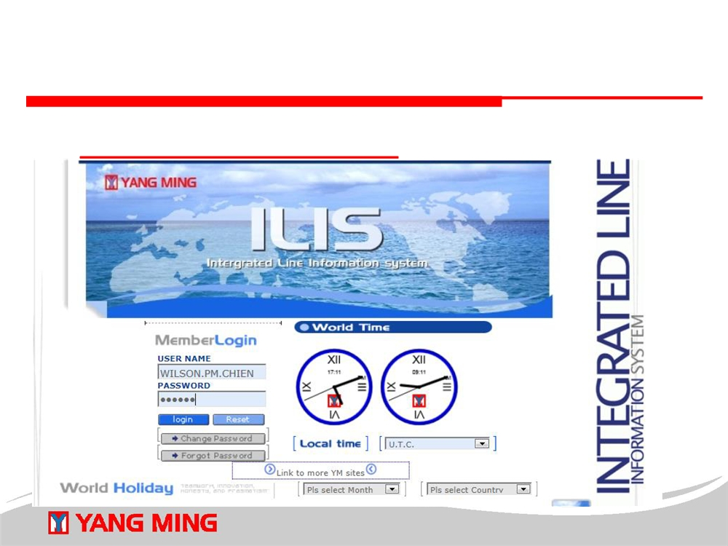
PARTNER’S DG POLICY LOCATION
• as2.yangming.com/ilis
7

Slide 8
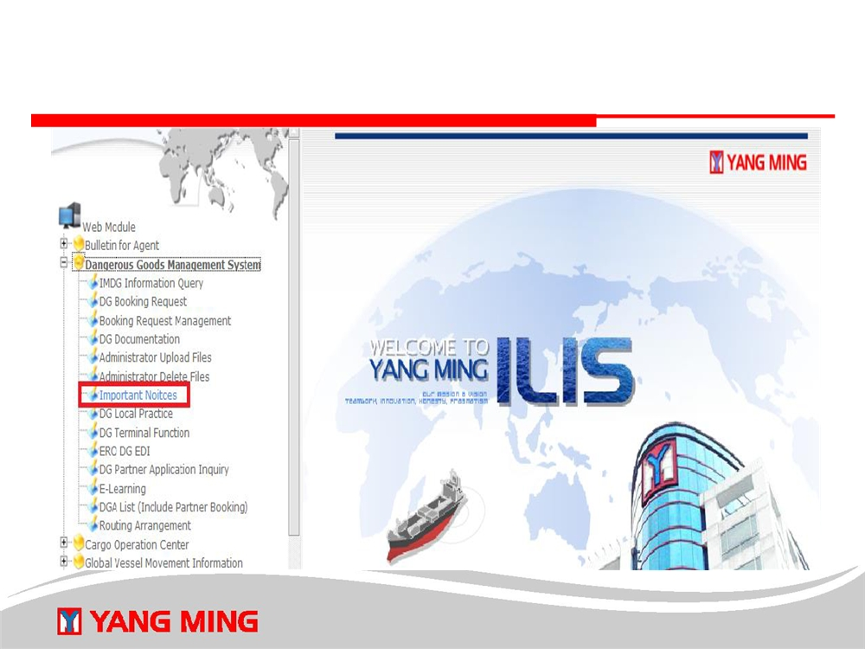
PARTNER’S DG POLICY LOCATION
8

Slide 9
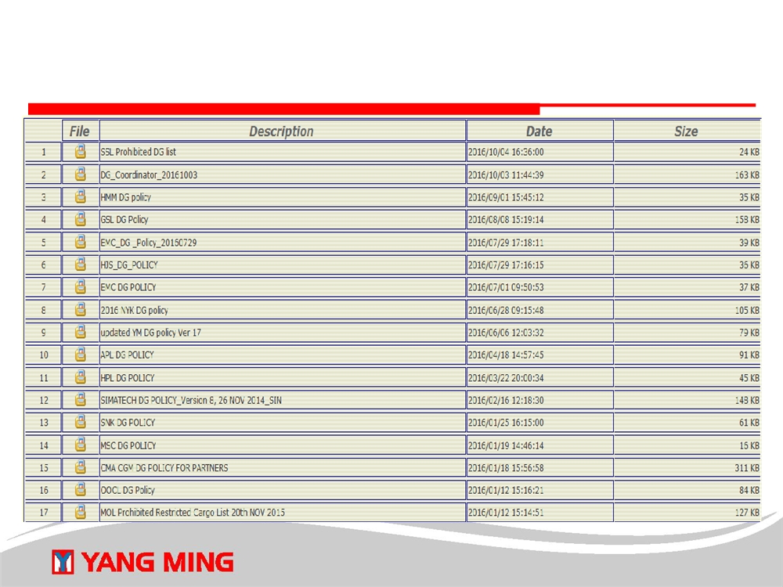
PARTNER’S DG POLICY
9

Slide 10
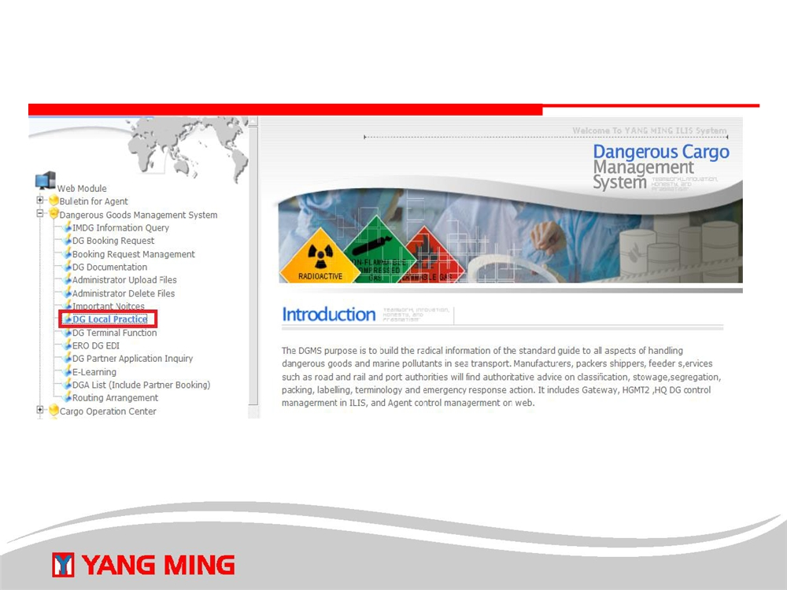
PORT REGULATIONS(LOCAL PRACTICE)
10

Slide 11
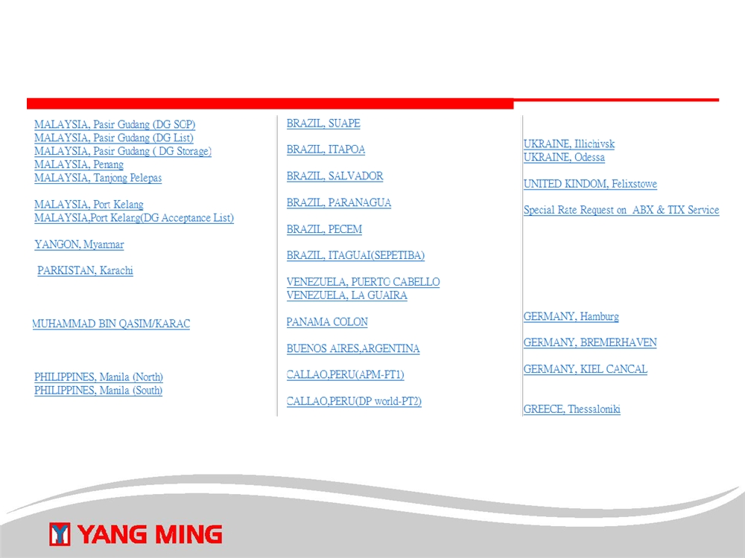
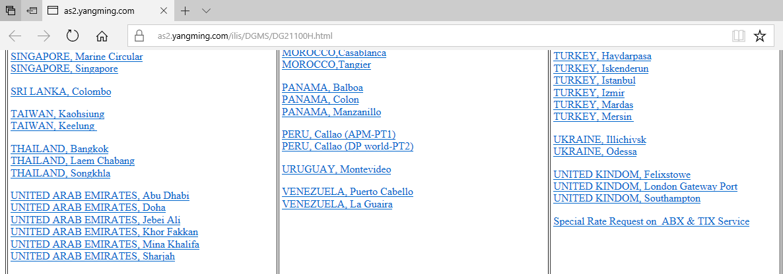
PORT REGULATIONS(LOCAL PRACTICE)
11

Slide 12
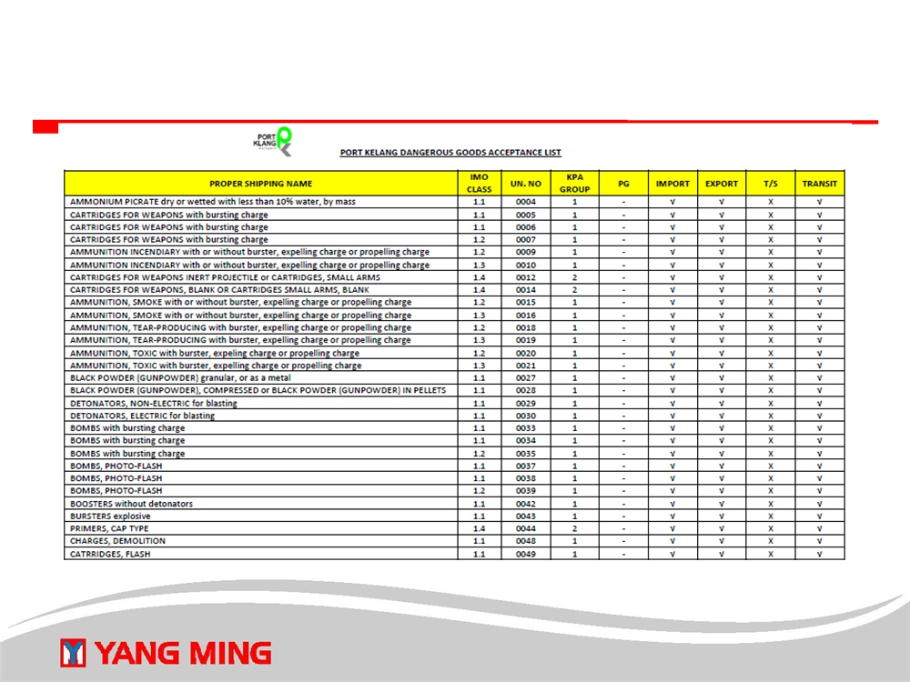
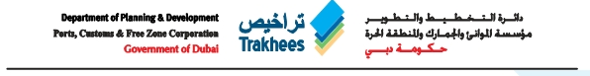
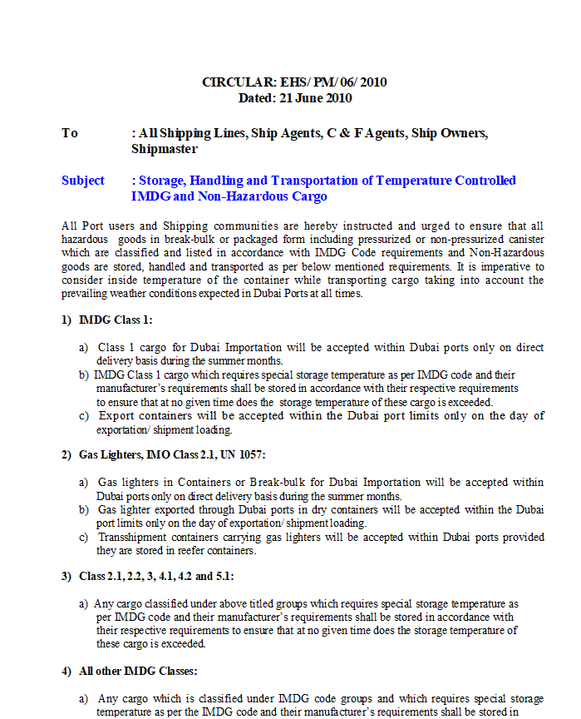
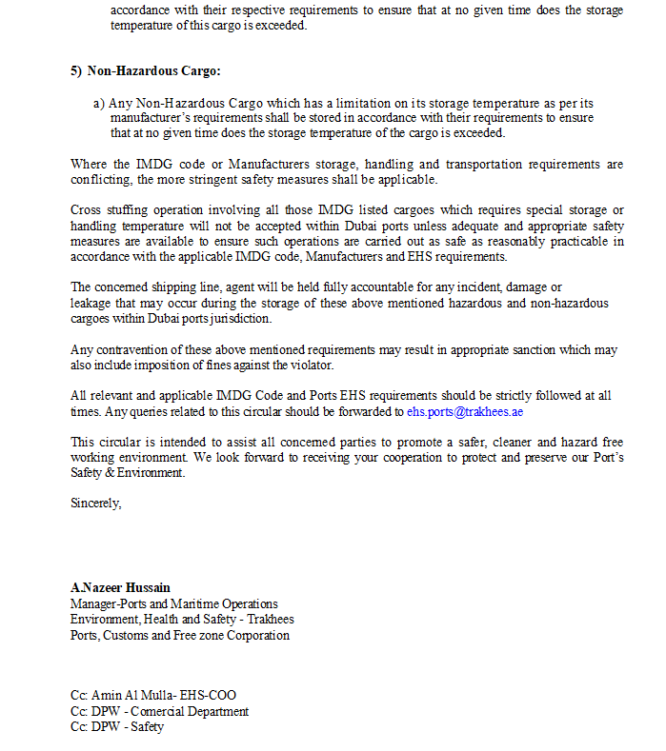
12
12

Slide 13
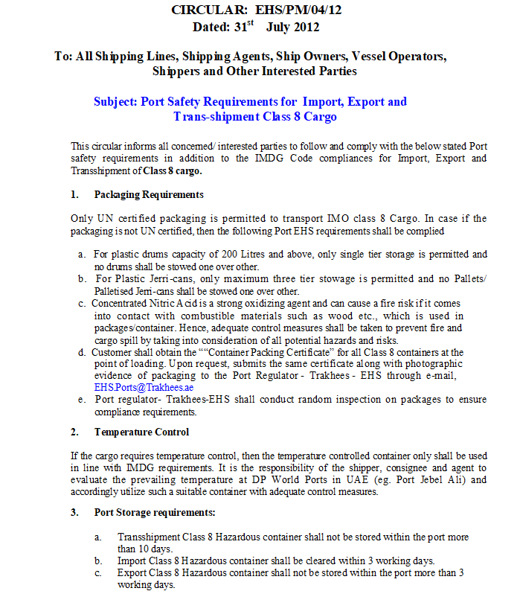
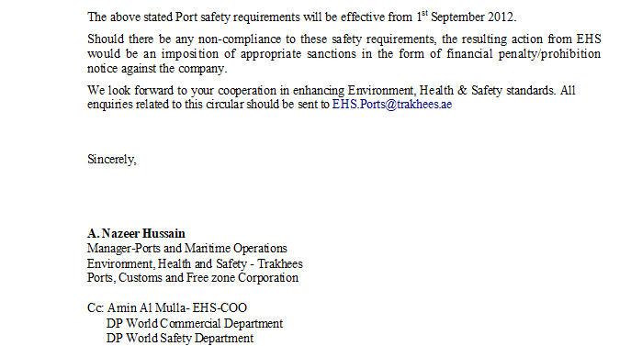
13

Slide 14

DG CARGO BOOKING
• Request DG information from customers
• Ensure the packaging are UN classified
• Make DG application via DGMS
- as2.yangming.com/ilis DGMS/DG Booking Request Management
• Get approval from DG center (LODG)
• Release empty container to customers
14

Slide 15

BEFORE LOADING
• Inspect DG declaration & packing certification were
signed & clear
• Ensure label/mark/placard correct
- www.yangming.com service/Dangerous cargo/The Shipper’s
Responsibilities for Dangerous Cargo
• Provide CBF with DG approval number to planner
lofc@yangming.com / losp@yangming.com or individual
captain in charge
• OP matters
15

Slide 16
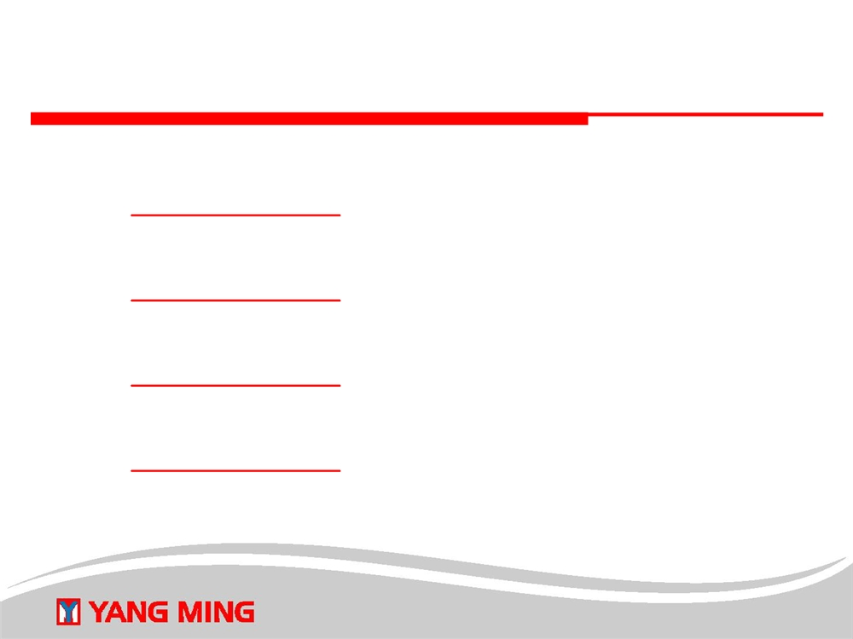
DOCUMENTING
Upload DG declaration for export
- as2.yangming.com/ilis DGMS/DG Documentation
Upload DG manifest for export
- as2.yangming.com/ilis DGMS/DG Documentation
Download DG declaration for import
- as2.yangming.com/ilis DGMS/DG Documentation
Download DG manifest for import
- as2.yangming.com/ilis DGMS/DG Documentation
16

Slide 17

EDUCATING IMDG CODE
• IMDG Code E-Learning
- as2.yangming.com/ilis DGMS/E-Learning
- Everyone handling with dangerous goods, including Sales / Operation / Customer Service / Document has to pass the examination. It proves related persons had been trained well according to the IMDG Code Chapter 1.3 requirements.
• Lecture demands
- If you need a lecture of IMDG code or some specific instructions, e.g. DG stowage & segregation & SDS, please contact with DG center
(LODG).
17

Slide 18
SPECIAL DG PROJECT
• If there is a business listing on Yangming prohibited DG list, you shall ensure the safety then promote it to DG center.
• But, you have to ensure the manufacture is definitely reliable and well-noted and trusted with large profit to Yangming also with a sustained amount in legality on all of international conventions & national laws & port authority’s rules.
18

